Slide 1
Workshop: Improving Railroad Safety through Understanding Close Calls
John Grundmann Presentation

Slide 2
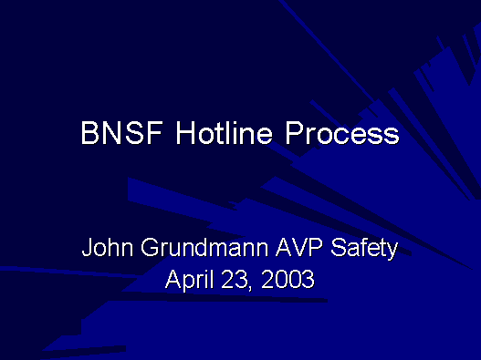

Slide 3
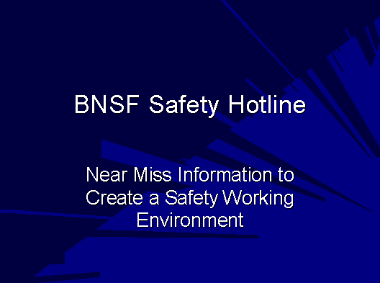

Slide 4
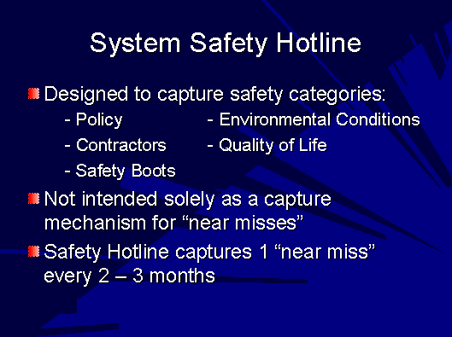

Slide 5
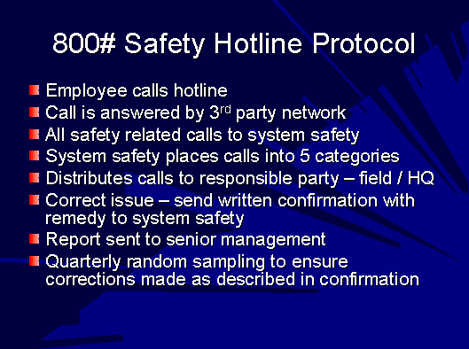

Slide 6
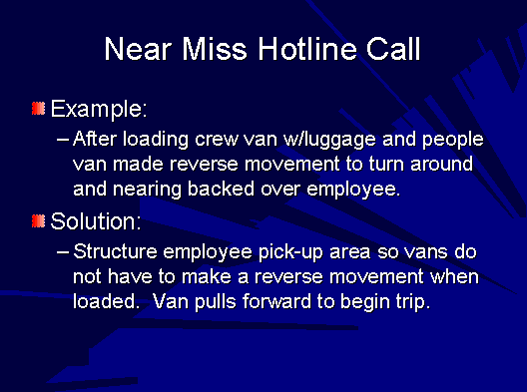

Slide 7
