Slide 1
FEDERAL RAILROAD ADMINISTRATION
FY 2015 Budget &
Four-Year Reauthorization Proposal
[March 6, 2014]

Slide 2
Rail Safety and Reauthorization in the Budget
The Department of Transportation requests $40 million for a new Safe Transportation of Energy Products fund that would be available to FRA, PHMSA, and FMCA to respond to increased shipment of crude oil
The President’s Budget requests $185.25 million to support FRA’s portfolio of rail safety and develop­ment programs.
This level will support 45 new staff, including 30 safety-related staff, which FRA plans to hire in FY 2014.
The reauthorization proposal’s key priorities include:
Supporting the implementation of PTC systems nationwide.
Establishing science-based regulations for hours of service.
Harmonizing railroad operating rules to create a safer working environment.
Encouraging use of noise mitigation technologies.
Implementing nationwide rollout of C³RS.

Slide 3
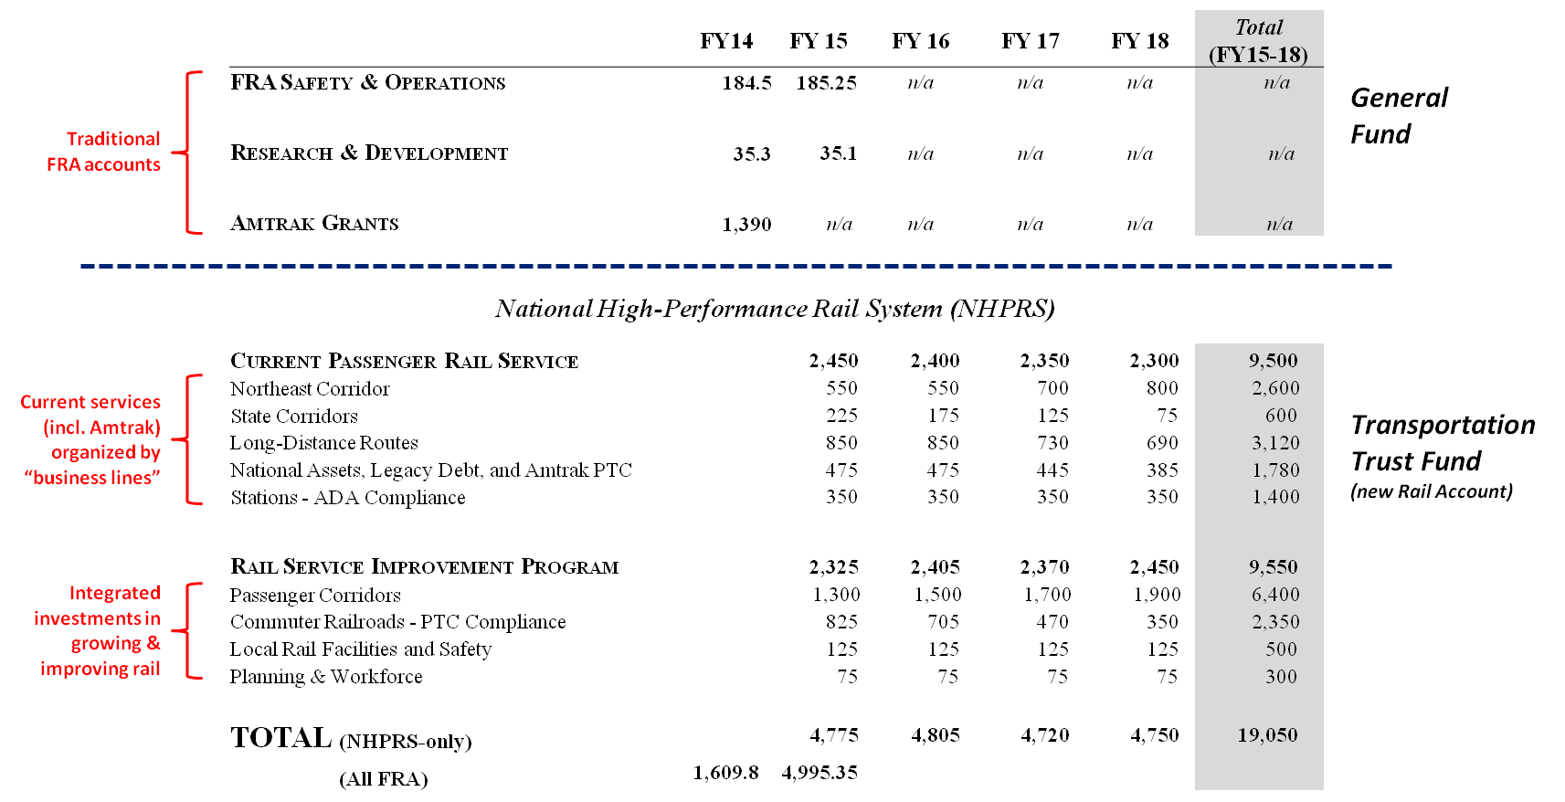
FRA FY 2015 budget and four-year reauthorization

Slide 4
Current Passenger Rail Service (FY15 Request = $2.45 billion)
Program Area | Eligible Activities | Eligible Recipients
Northeast Corridor $550 million | Ongoing equipment overhaul capital needs. Backlog of state of good repair capital needs. * Replacement of legacy/obsolete equipment. * Offset by user “access” charges (phased in). | Amtrak
State Corridors $225 million | Replacement of legacy/obsolete equipment.* Transitional assistance to support phase-in of fixed asset capital charges to States under PRIIA Section 209.* | States
Long-Distance Routes $850 million | Long-distance route capital – equipment overhauls and replacement, stations, maintenance facilities. Long-distance route operations. | Amtrak
National Assets, Legacy Debt, and Amtrak PTC $475 million | Operating and capital needs for national reservations system; security and policing; training centers; and other national backbone systems. PTC capital on Amtrak routes* Legacy debt service and principal. * | Amtrak
Stations – Americans with Disabilities Act Compliance $350 million | Capital to upgrade Amtrak-served stations to be ADA compliant. * | Amtrak
* temporary activities

Slide 5
Rail Service Improvement Program (FY15 Request = $2.325 billion)
Program Area | Eligible Activities | Eligible Recipients
Passenger Corridors $1.3 billion | Environmental studies Right-of-way acquisition Preliminary engineering Design and construction Rolling stock acquisition Congestion mitigation projects identified by the Surface Transportation Board or DOT | States and multi-State entities Amtrak Equipment entity
Commuter Railroads – PTC Compliance $825 million | PTC capital on commuter railroads. * | States Commuter railroads
Local Rail Facilities and Safety $125 million | Highway-rail grade crossing improvements Rail line relocation projects Capital upgrades to short-line freight railroads Training and technical assistance for local governments | States and multi-State entities Local governments
Planning and Workforce $75 million | National, multi-state, state planning Corridor and terminal area planning and environmental analyses Capital upgrades to the Transportation Technology Center Rail-based University Transportation Centers National Cooperative Rail Research Program Support for Buy America implementation | States and multi-State entities Metropolitan planning organizations Transportation Research Board University Transportation Centers Manufacturing Exchange Partnership FRA
* temporary activities

Slide 6
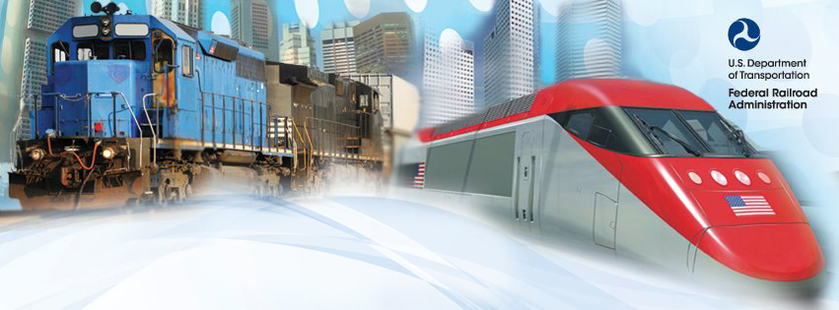
Connect with us
facebook.com/USDOTFRA
twitter.com/USDOTFRA
Thank you

